Slide 1


International University
MICRO-PROCESSING SYSTEM
Lecture 3D:
AVR Assembly to Hex Compiler Tutorial
Vo Minh Thanh, M.Eng
School Of Electrical Engineering

Slide 2
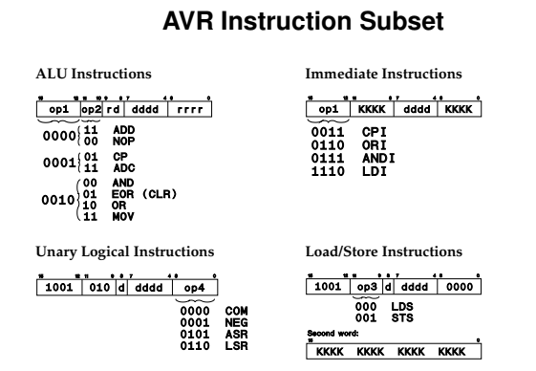

Slide 3
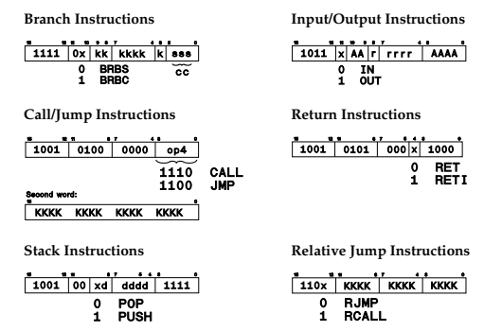

Slide 4
AVR Assembly Example code
ldi r16, 0x20
out DDRB, r16 // set PB5 to output
loop:
out PINB, r16 // toggle PB5
ldi r17, 0xff
wait:
dec r17
brne wait
rjmp loop

Slide 5
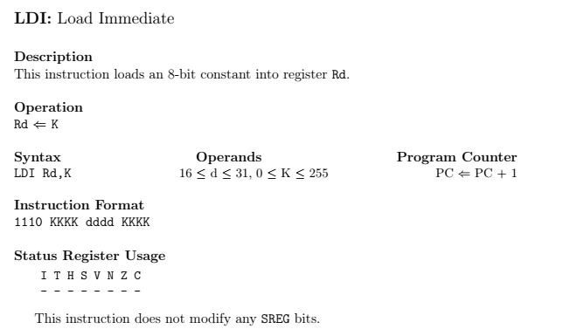
Instructrion complile
asm bin hex
ldi r16, 0x20
ldi r17, 0xff 1110 1111 0001 1111 ef1f

Slide 6
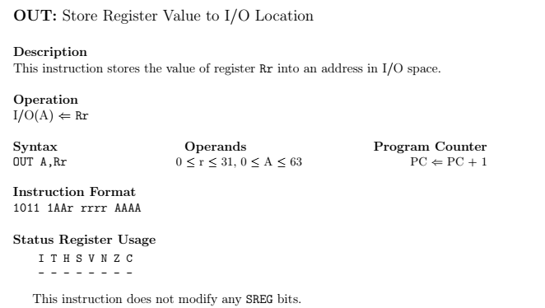
Instructrion complile
asm bin hex
out 0x37, r16
out 0x24, r25

Slide 7
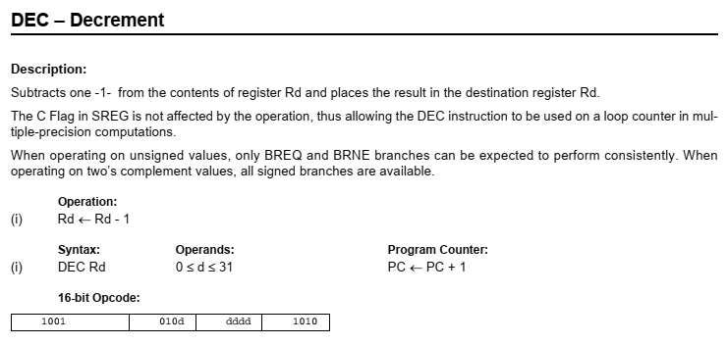
Instructrion complile
asm bin hex
dec r17 1001 0101 0001 1010 951a

Slide 8
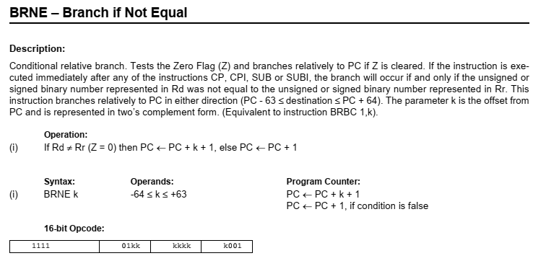
Instructrion complile
asm bin hex
brne -2 1111 0011 1111 0001 f7f1

Slide 9
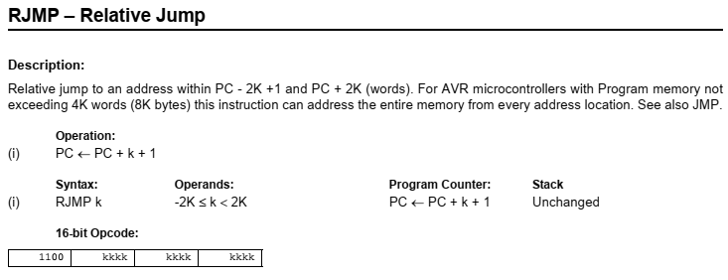
Instructrion complile
asm bin hex
rjmp -5 1100 1111 1111 1011 cffb

Slide 10
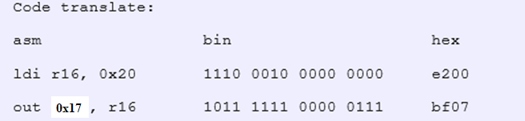

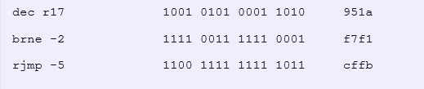
AVR Assembly complile to Hex
ldi r16, 0x20
out DDRB, r16
loop:
out PINB, r16
ldi r17, 0xff
wait:
dec r17
brne wait
rjmp loop

Slide 11
AVR Assembly complile to Hex
write a hexfile
For flashing, the program needs to be in the intel HEX format.
:[Data Size] [Start Address] [Record Type] [Data] [Checksum]
which gives:
: 0E00000000E27BF06BBF1FEF1A95F1F7FBC F1E

Slide 12
AVR Assembly complile to Hex
Exercise 1: Convert Following AVR Assembly to Binary code then machine hexa code:
.include "m32def.inc"
.org 0
rjmp main
main:
ldi r16, 0x20
out DDRB, r16
sbi PORTB, 6
loop_main:
sbis PINB, 6
rjmp button_led
cbi PORTB, 5
rjmp loop_main
button_led:
sbi PORTB, 5
rjmp loop_main

Slide 13
AVR Assembly complile to Hex
Exercise 2: Convert Following AVR Assembly to Binary code then machine hexa code:
LDI R22, 0xFF
OUT DDRB, R22
OUT DDRD, R22
LDI R24,0x00
OUT DDRC,R24
LDI R20,0xB5
loop: IN R18, PINC
OUT PORTB, R18
CPI R18,0xAA
BREQ Check
DEC R20
rjmp loop
Check: LDI R25,0x55
OUT PORTB,R25
rjmp loop

